Slide 1
System Level Testing

Slide 2
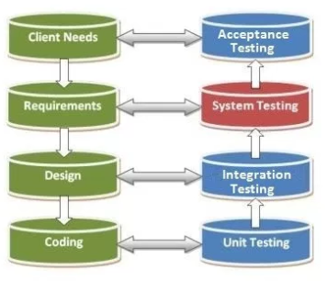
System level testing is testing the system as a whole

Slide 3
Testing types
Unit Testing – Testing individual units, or functions in a program to verify they do what is intended… do my functions work?
Integration Testing – Verifying that the units work together as a group to produce a desired result… do my functions work together?
System Testing – Testing the program as a whole to see if it meets the requirements of the program… does the program do what I meant for it to do?
Acceptance Testing – Intended users test the program to see that it meets what they want or is practical for their needs… is it accepted?

Slide 4

Instead of testing individual units, you test use cases

Slide 5

The more specific the test, the better

Slide 6
Use Case Examples

Slide 7
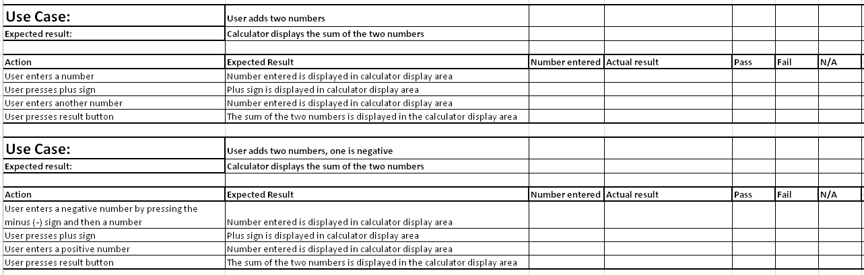
Use Case Examples

Slide 8
Sources
The Four Levels of Software Testing - https://www.seguetech.com/the-four-levels-of-software-testing/
System Testing: What? Why? How? - http://www.softwaretestingclass.com/system-testing-what-why-how/

